Slide 1
How to Efficiently Encode Chromatic Natural Images in the Retina
David St-Amand, Greg Field, John Pearson

Slide 2
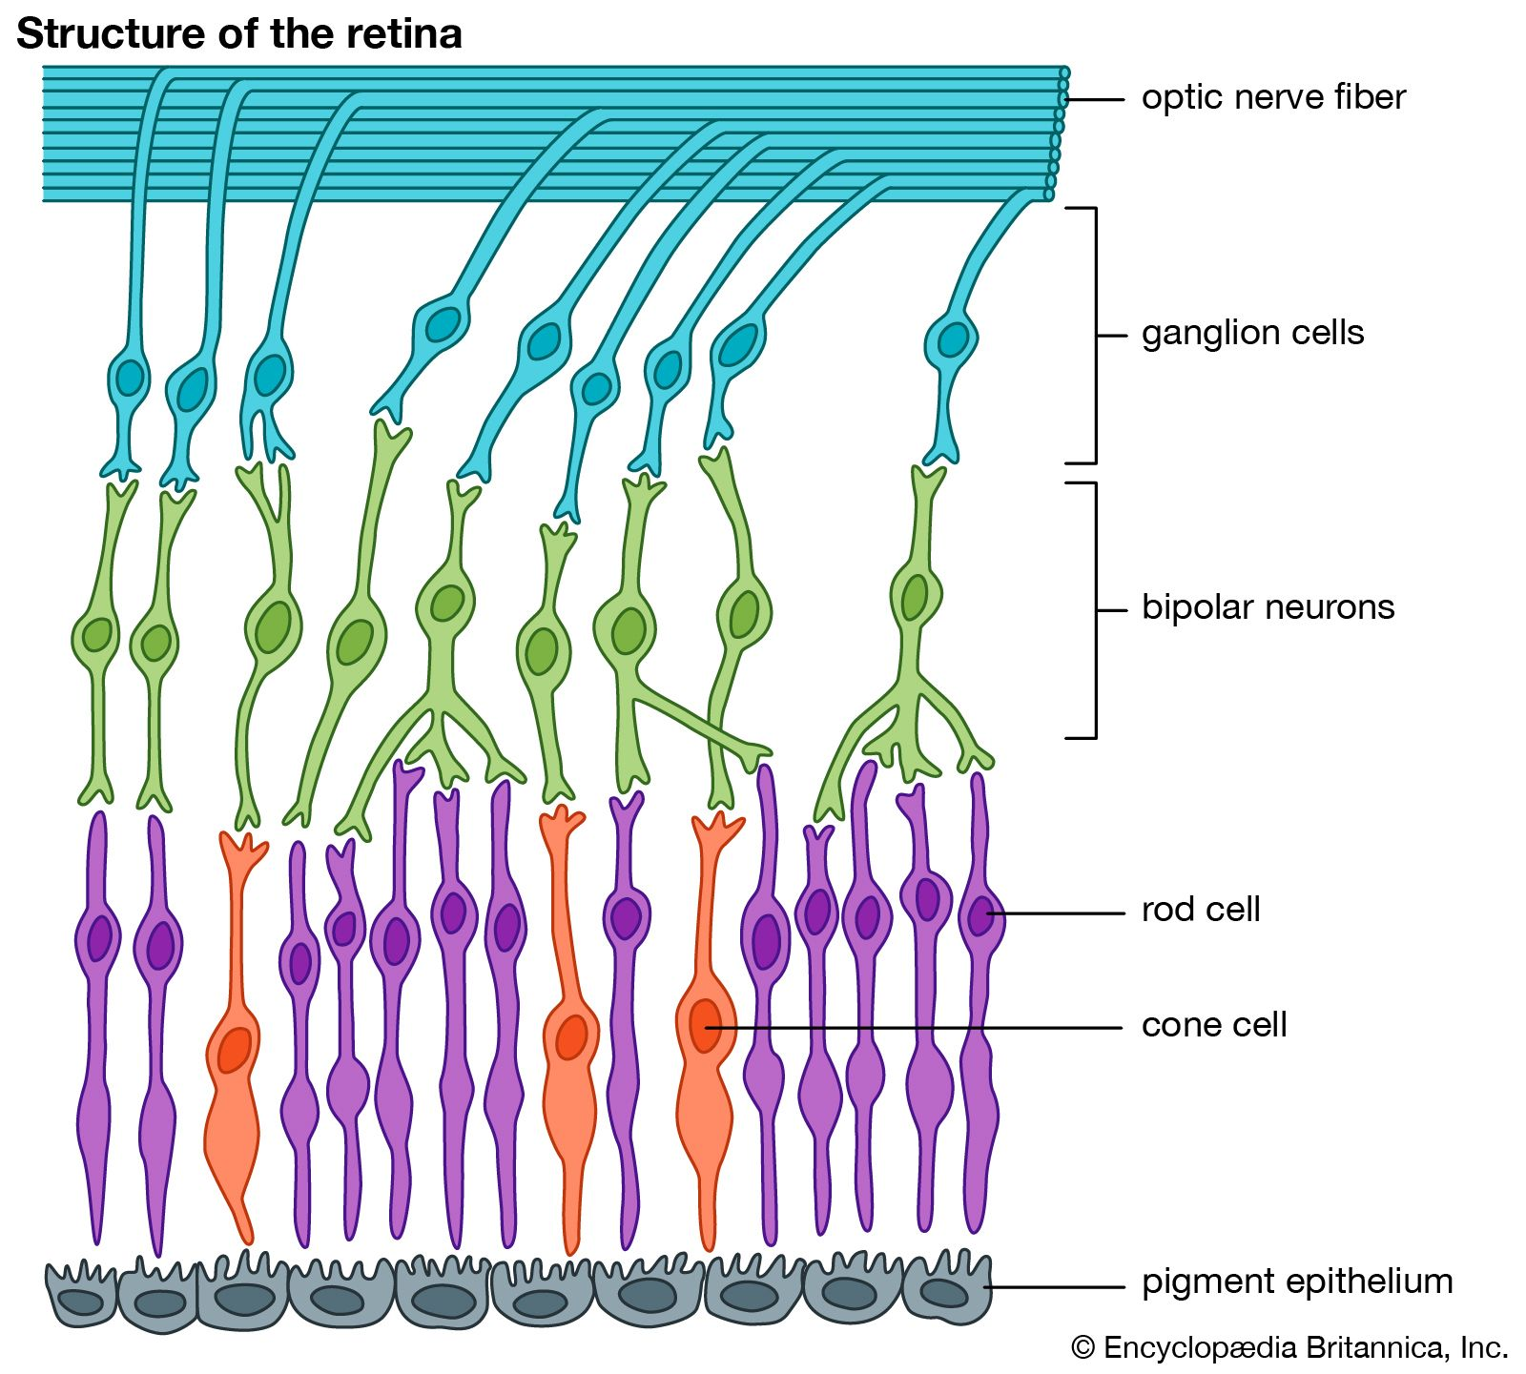
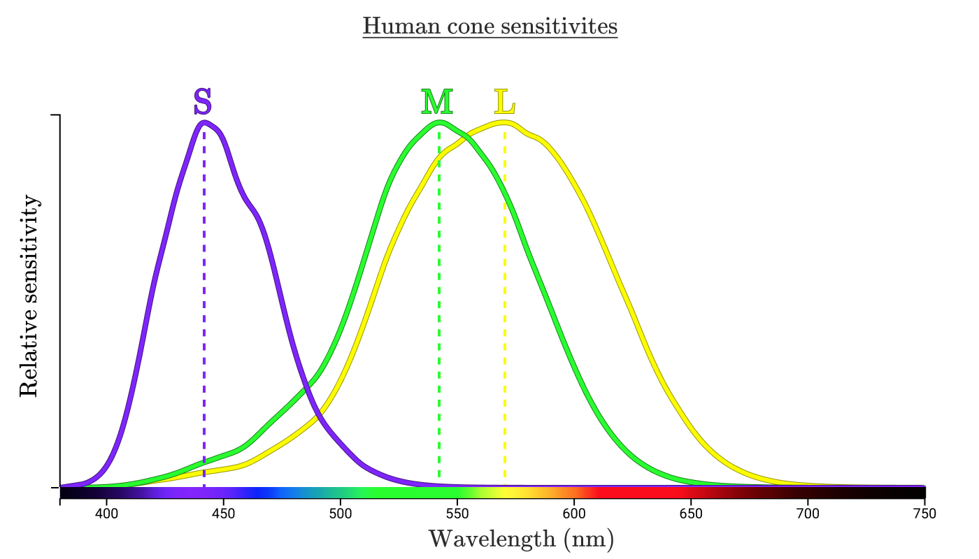
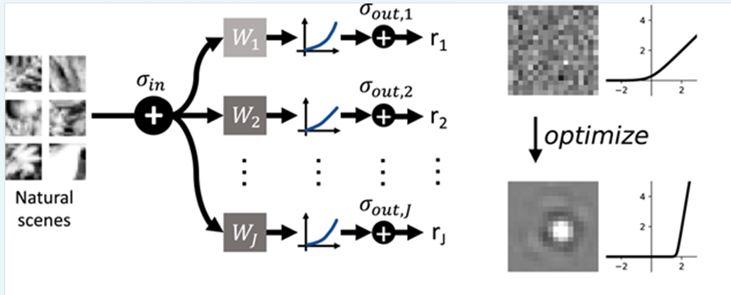
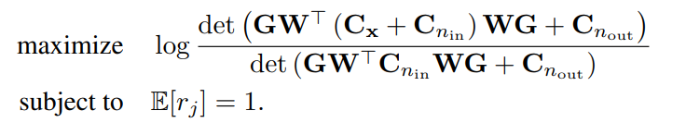

How to efficiently encode chromatic natural images in the retina
David St-Amand, Greg Field and John Pearson
Pearson Lab, Neurobiology Department, Duke University, Durham, NC, USA
Introduction
Results
Results
Efficient coding: Sensory systems should efficiently encode their inputs
Efficient coding has been very successful at explaining how the retina encodes (black and white) natural images
However, the efficient strategy to encode chromatic natural images is less well understood
Cones in the retina:
Conclusion
Methods
References
Maximize mutual information:
I(X;Y) = H(Y) – H(Y|X)
Firing rate constraint:
E[r_j] = 1
Model parameters:
12x12x3 inputs
500 neurons

